Slide 1
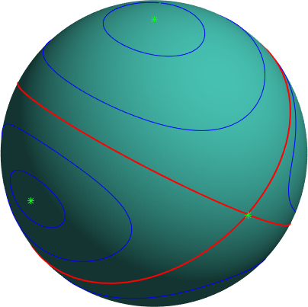
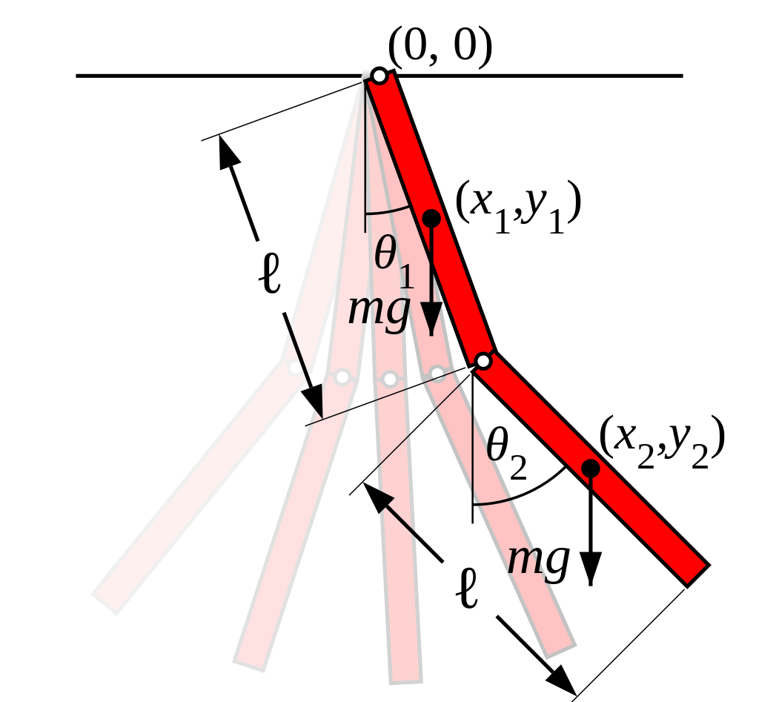
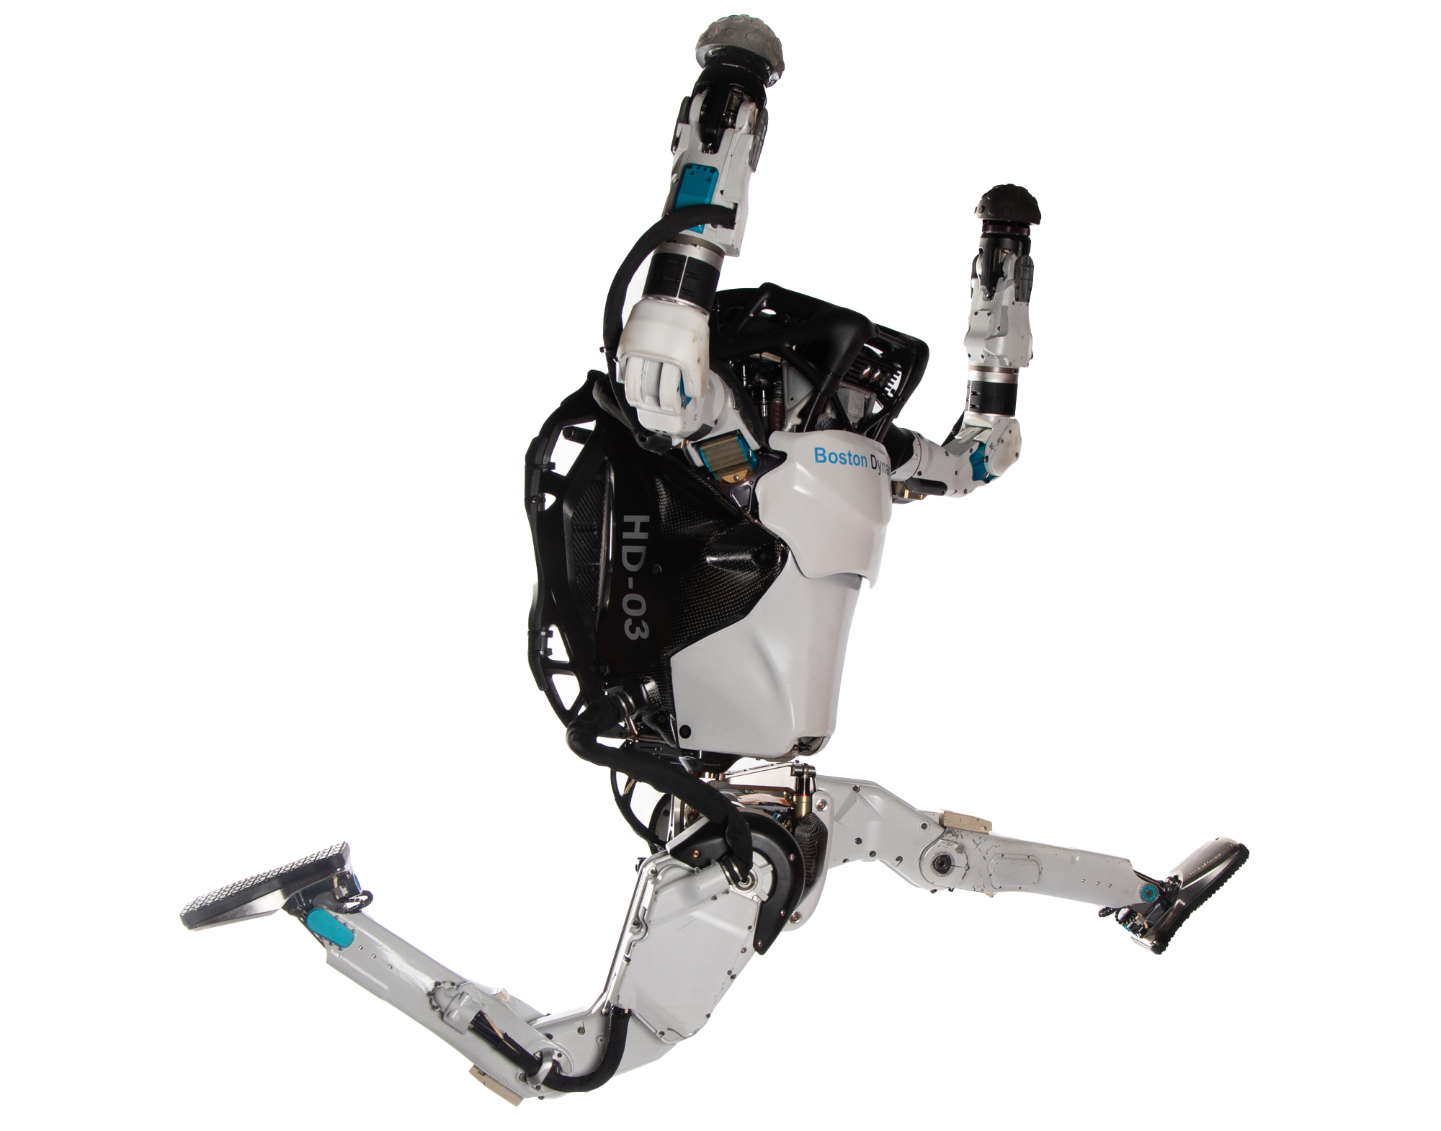
Dynamics
16.07
Fall 2026

Slide 2



Course Team
Zac - Instructor
John - TA
Patrick - Postdoc
Jon - Postdoc

Slide 3
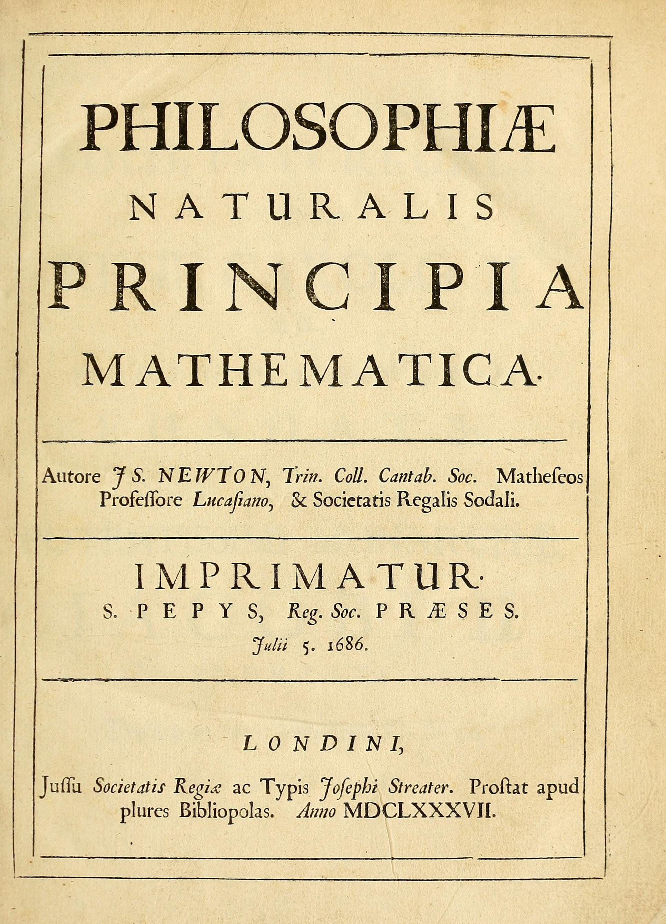
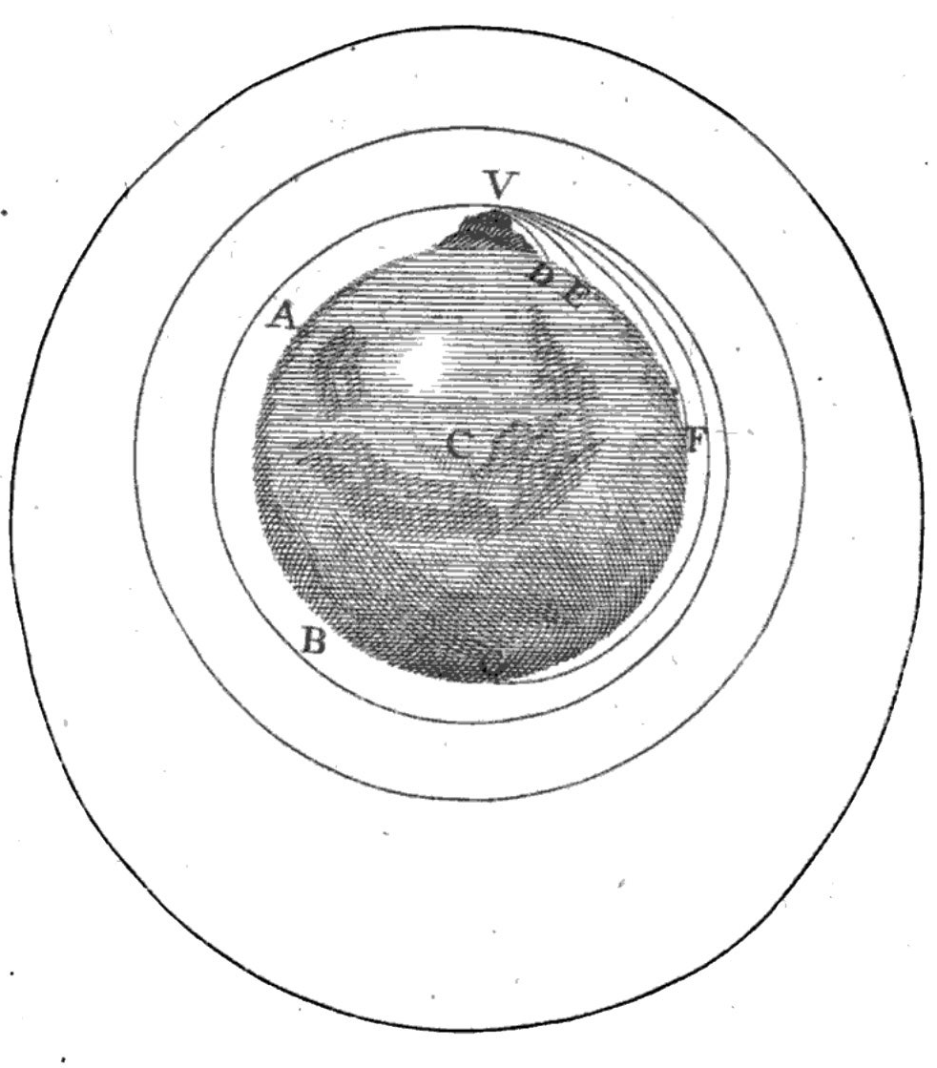
A Brief History of Dynamics
Notes:
First published in 1687
The birth of modern physics, arguably modern science
Primarily dealt with gravitation and orbital mechanics
Also treats pendulums and viscous damping
Very geometric flavor
F=ma

Slide 4
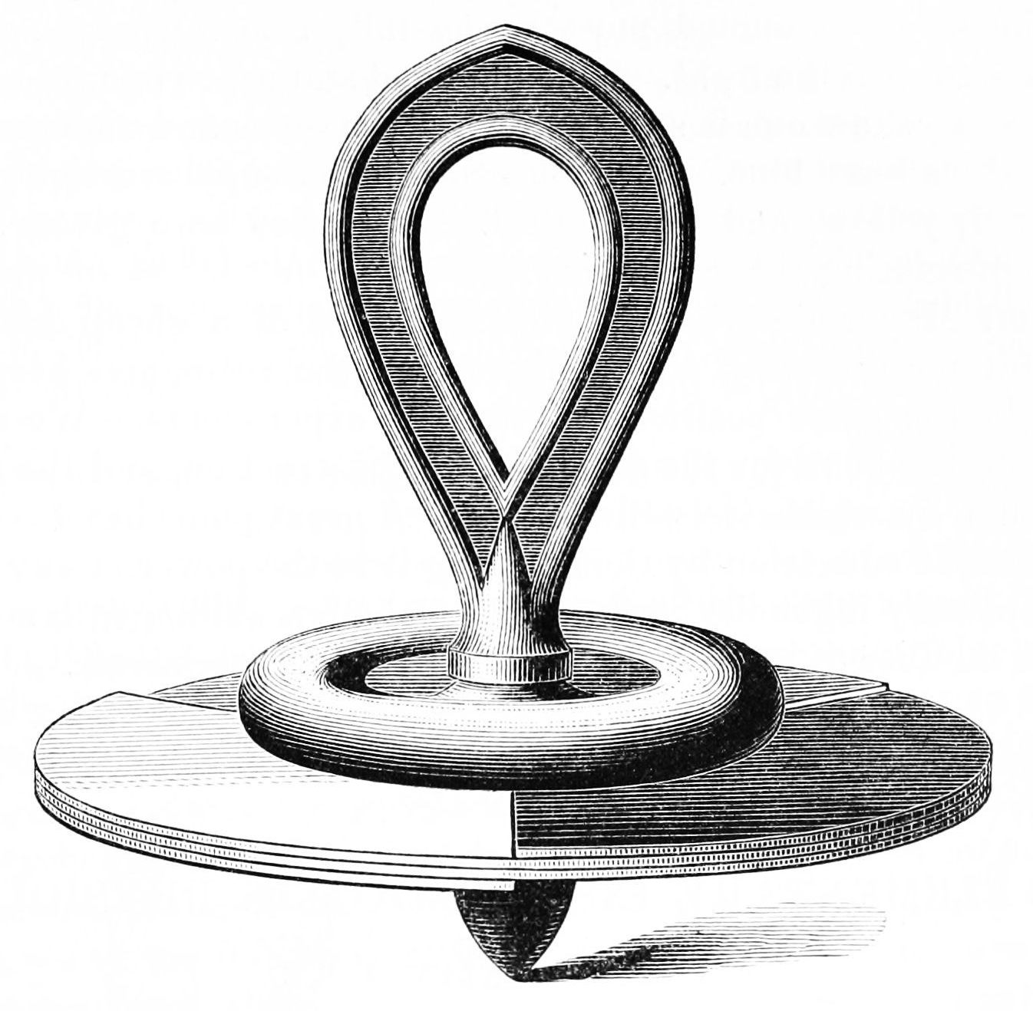
A Brief History of Dynamics
Notes:
Developed over many years but full theory first published in 1765
Extended Newtonian point-mass mechanics to extended rigid bodies with both position and orientation
Introduced concepts of moment of inertia, inertia tensor, Euler angles, and Euler’s equation for rigid-body motion
Motivation at the time was to model and understand the motion of ships
Analyzed spinning tops and rotation of planets

Slide 5
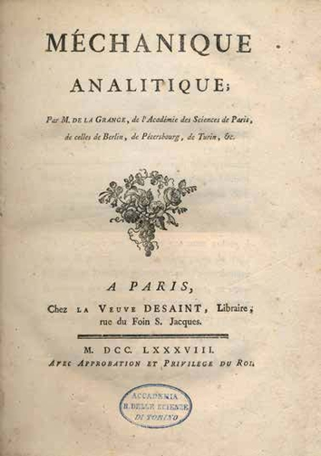
A Brief History of Dynamics
Notes:
Lagrange, also large contributions from D’Alembert. Published 1788
Deliberately throws out the geometric/vector based picture from Newton in favor of a more “analytic” approach. No pictures.
Major advancement: re-formulates Newton’s laws in a coordinate-independent way.
We no longer have to draw free-body diagrams or think about force vectors if we don’t want to
Very powerful – still widely used and is (one of) the most practical and useful methods for deriving equations of motion

Slide 6
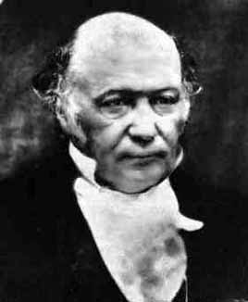
A Brief History of Dynamics
Notes:
Hamilton’s Principle/Least action (1833)
Re-formulates mechanics as an optimization problem
The trajectory that the system follows is the one that minimizes a cost/objective/loss function called the action
Lots of ways to generalize this: we can use any coordinates we want for position and velocity independently, we can add constraints, etc.
Provides a bridge between dynamics and numerical optimization that leads to state-of-the-art simulation algorithms
Also developed quaternions to describe 3D rotations, which are standard in aerospace and computer graphics applications

Slide 7
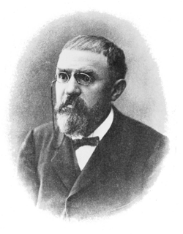
A Brief History of Dynamics
Notes:
Poincare (1880s) worked on the three-body problem motivated by a prize offered by the King of Sweden
People at the time were trying to find analytical solutions
Poincare essentially showed that you couldn’t find one in general
First work on what we now call Chaos theory
Initiated modern field of dynamical systems theory, which is about qualitatively understanding dynamics when we can’t find closed-form solutions (equilibria, stability, limit cycles, etc.)
These ideas underlie modern space mission design that leverages N-body gravitation effects to find low-thrust/low-energy trajectories

Slide 8
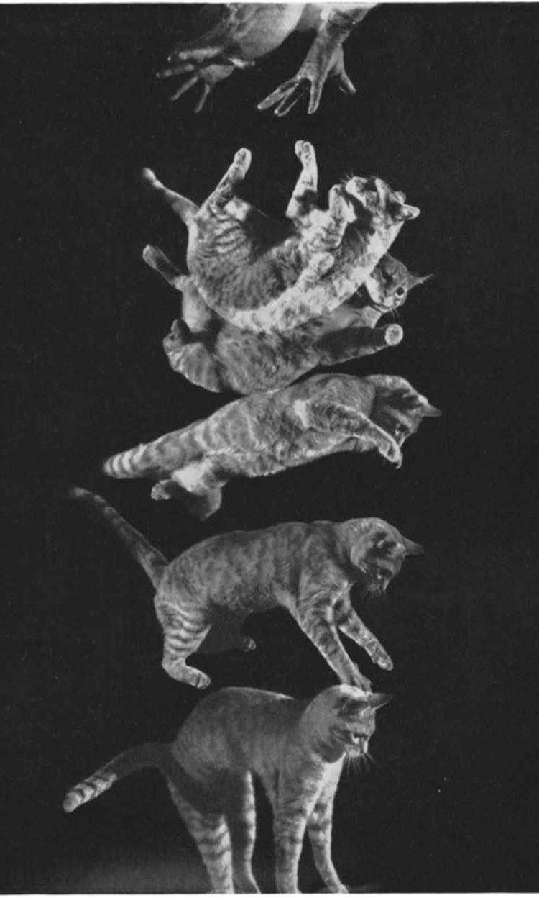
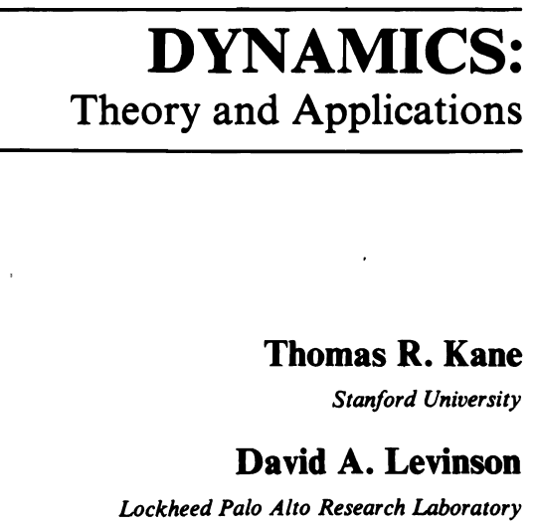
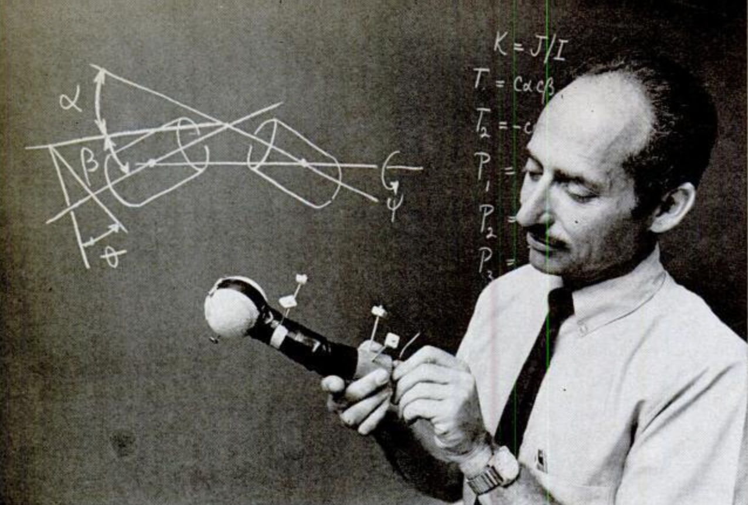
A Brief History of Dynamics
Notes:
Thomas Kane (1950s-1970s)
Kane’s Method/Equations (1950s-60s)
Another formulation of classical mechanics
Slightly more flexible than Lagrangian in that it allows choosing position and velocity coordinates independently
Widely used in aerospace industry
Novelty: focus on computational efficiency
More importantly(?): developed (with students) on of the first software packages for multi-body dynamics (Autolev)

Slide 9
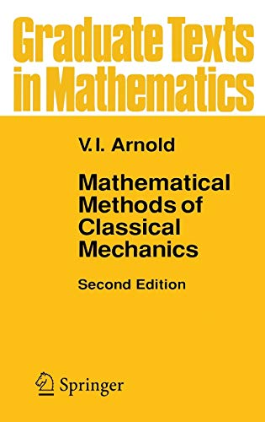
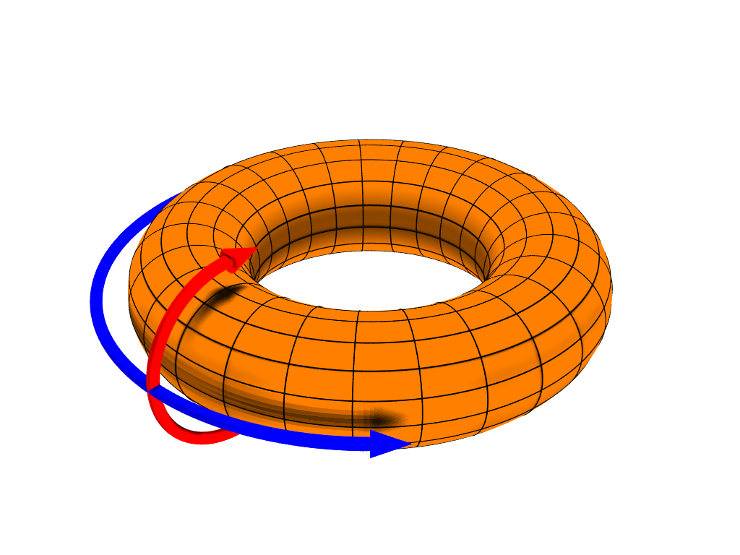
A Brief History of Dynamics
Notes:
Arnold + Marsden (1960s-70s)
Geometric Mechanics
Applying ideas from differential geometry to dynamics
Provides lots of insight into mathematical structure, conservation laws, etc.

Slide 10
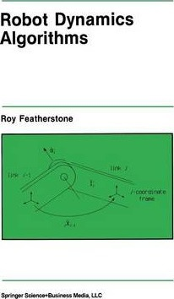
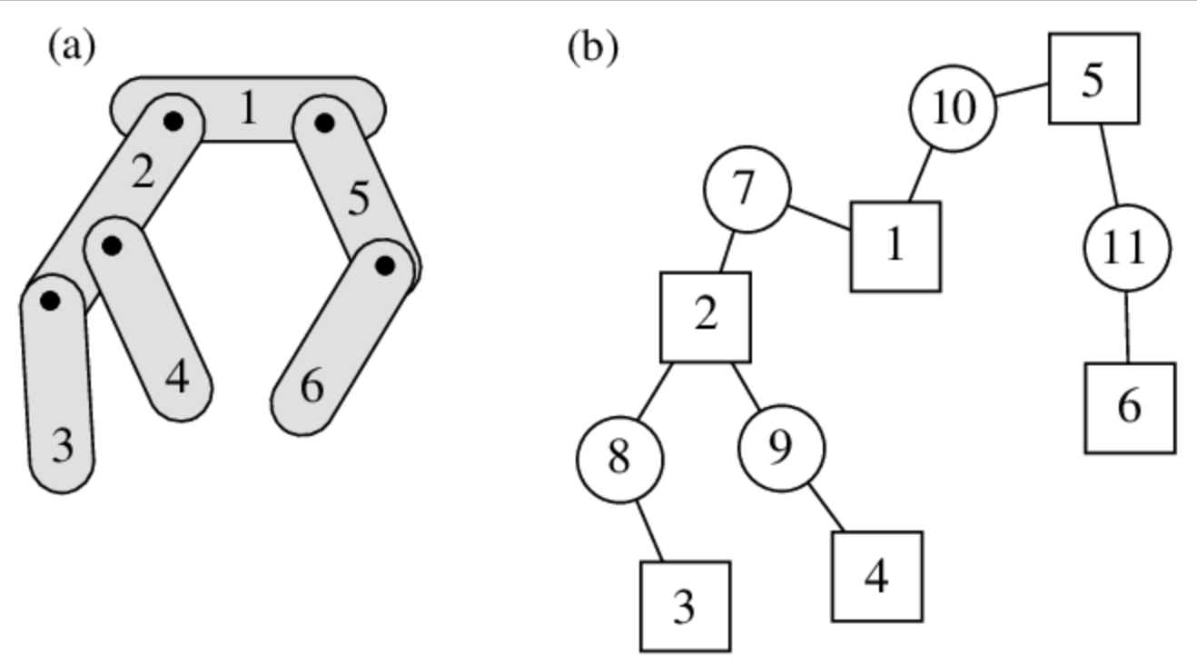
A Brief History of Dynamics
Notes:
Roy Featherstone (1980s)
Developed first general linear-time algorithms for dynamics
Deals explicitly with serial-chain manipulators common in industrial robotics
Later extended to floating-base systems
Widely used in state-of-the-art simulators (MuJoCo, PyBullet, Dart, etc.)
David Baraff (1990s)
Showed how to compute dynamics in linear time from a Lagrangian perspective with explicit joint constraints
These methods exploit graph structure of the physical system (topology connections between links/joints) to find efficient ways of solving the equations

Slide 11

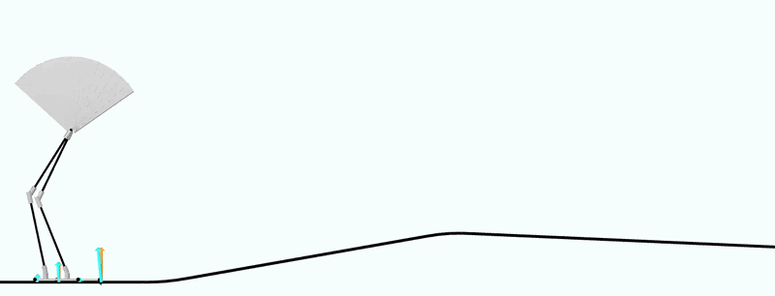
A Brief History of Dynamics
Notes:
Moreau (1970s-80s)
Stewart + Trinkle (1990s-2000s)
Time-stepping methods for simulating impacts + friction
Solve an optimization problem at each time step with contact constraints to compute impact + friction forces
Used in many current robotics simulators

Slide 12
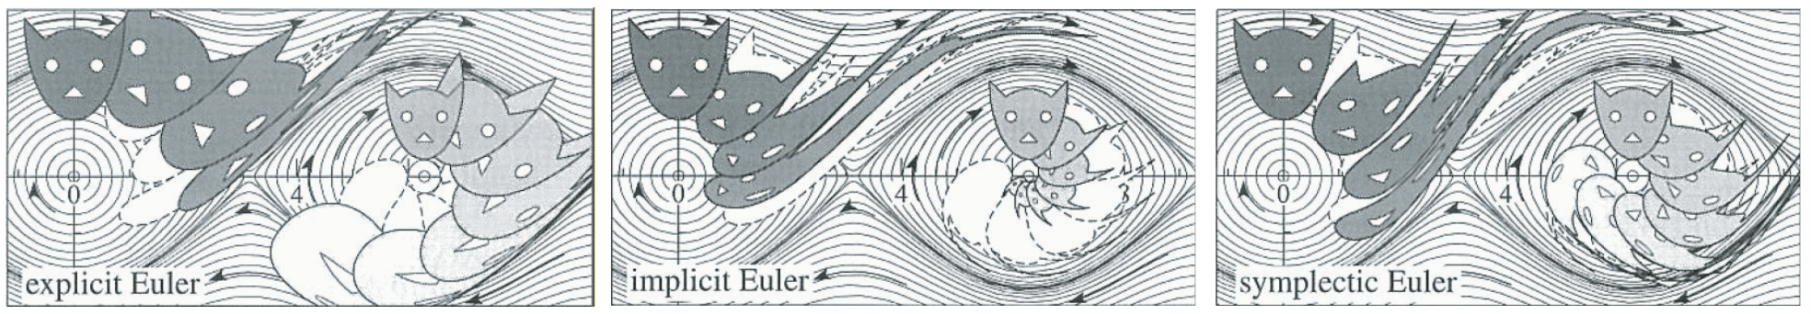
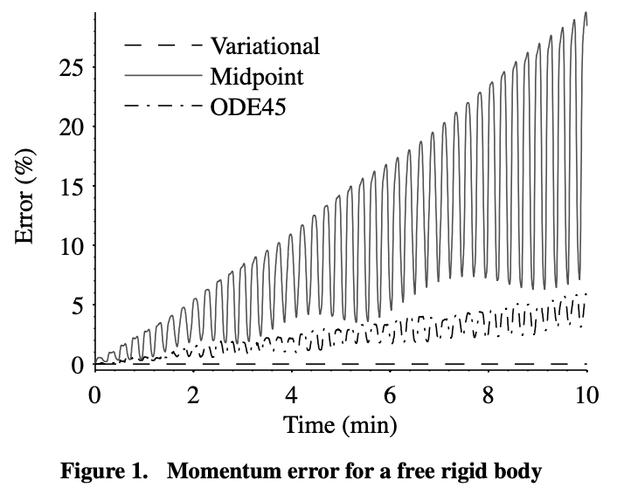
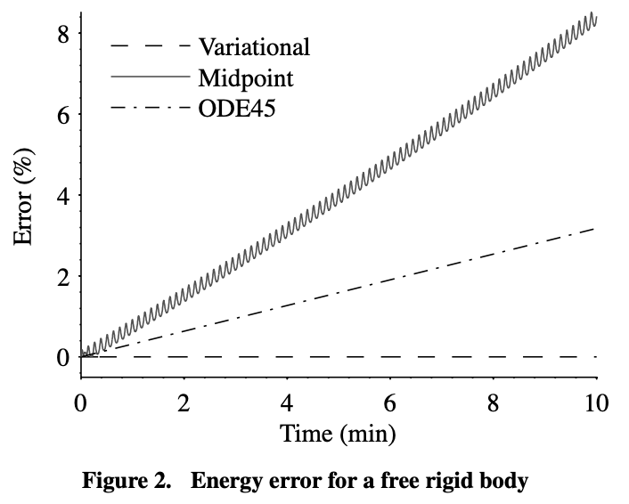
A Brief History of Dynamics
Notes:
Marsden + students (2000s)
Build numerical integration/simulation methods by directly discretizing the least-action principle instead of ODEs
Leads to algorithms that automatically satisfy conservation, symmetry, and constraint properties of the true system
Deep connections to optimal control
Still not very widely known/used, probably because theory is challenging

Slide 13
What Are We Doing Here?
Review of Newtonian point-mass dynamics
Coordinate systems and reference frames
Classical analytical methods (Lagrangian, etc.)
Orbit mechanics
Rigid and multi-body dynamics
Numerical simulation
Focus on aerospace and robotics applications

Slide 14
Logistics
Lectures in 35-225 (recordings will be posted)
Recitations in 35-225 (additional Office hours TBD)
No textbook – lecture notes will be posted
Piazza for course communication, Canvas for homework
Three labs during Friday recitation times – location TBD
In-class mid-term + cumulative final

Slide 15
Getting Started:
Fill out course survey:
https://forms.gle/Eif8SJwqJqssLBVa6
Join course Piazza:
https://piazza.com/mit/fall2026/1607

